Slide 1
Lappeenranta-Lahti University of Technology LUT MSc. Thesis seminar presentation
PLANKTON RECOGNITION USING SIMILARITY LEARNING
Presented: Ghebrehiwet Hagos
Supervised by: D.Sc. Tuomas Eerola
Prof. Lasse Lensu
Prof. Heikki Kälviäinen
June 03, 2021

Slide 2
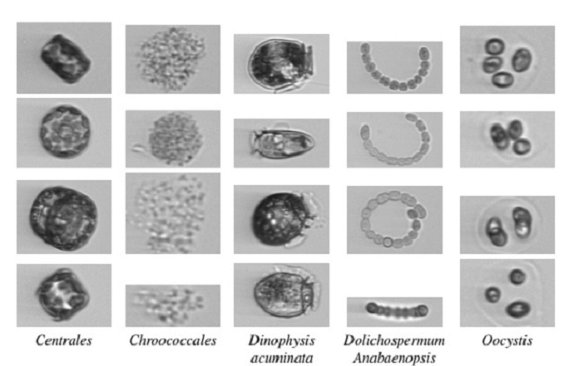
Introduction : Background, objective and overview
Introduction
Planktons are varied size aquatic microorganisms
Computer vision for plankton recognition:
Objective:
1. To implement and to train CNN-based on similarity learning for plankton images. 2. To develop a plankton classification system by utilizing the implemented similarity learning. 3. To evaluate the developed recognition system plankton image data.

Slide 3
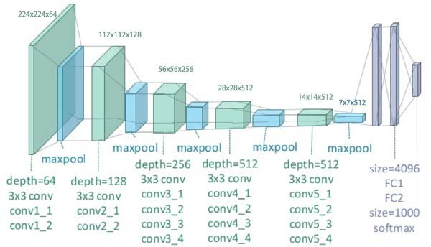
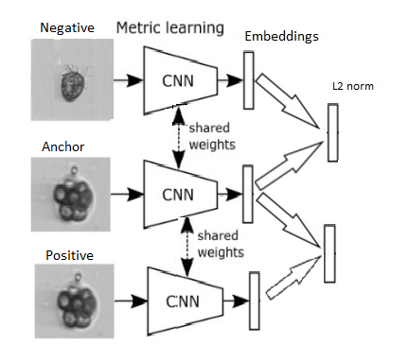
Proposed methods CNN, Triplet Siamese network and similarity classifier
Convolutional neural network: Feature extraction
VGG19 and VGG16 CNN
Siamese network using triplet learning
Triple loss learning
Embeddings
L2 norm(Euclidean distance )

Slide 4
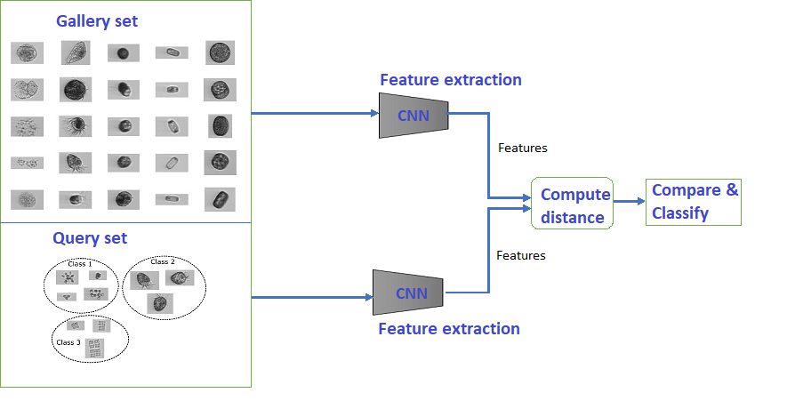
Classification approach
Gallery set
Gallery set images are obtained from the train set.
These images are selected randomly from each class.
Query set
Query images are a set of the image to be classified
Compute distance
Euclidean distance between query image and all the
gallery set images
Compare and classify
Sort the computed distance
Select the minimum distance

Slide 5
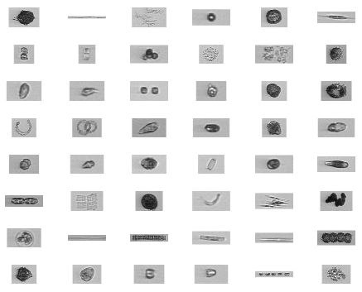
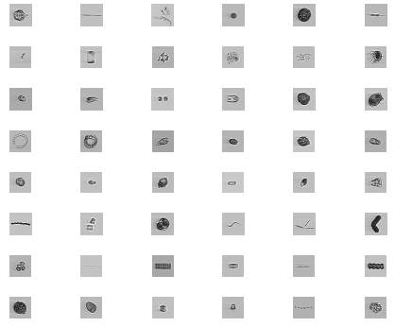
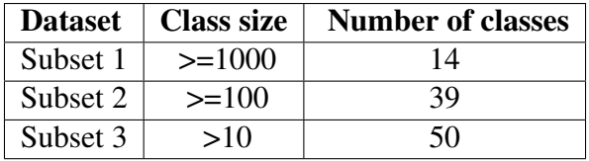
Data and data preprocessing
Data collection
Supplied by the Marine Research Centre of a
Finnish Environmental Institute (SYKE).
Before preprocessing
Data preprocessing:
Image resize, Padding, Gaussian noise, Images are normalization
Data Subsets
After preprocessing

Slide 6
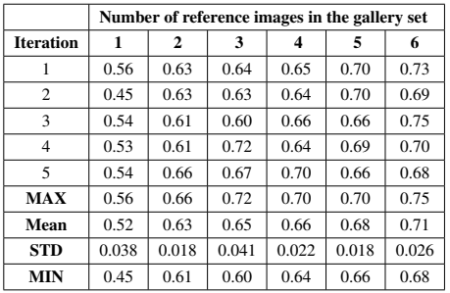
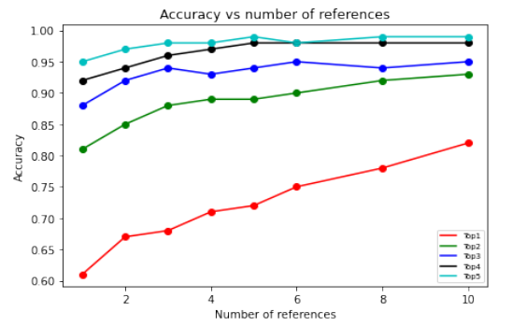

Results
Result on Subset 1 (14 classes): using VGG19 as feature extractor
Top-1 to top-5 on Subset 1 Effect of number of reference

Slide 7
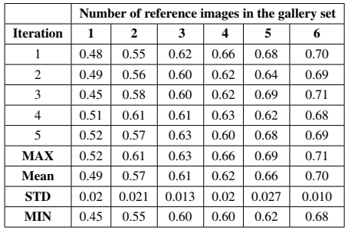
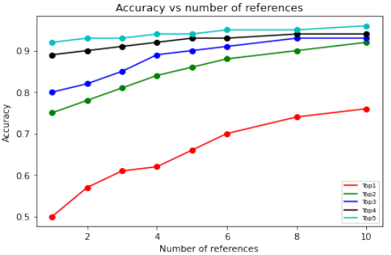

Results
Result on Subset 2 (39 classes): using VGG19 as feature extractor
Top-1 to top-5 on Subset 2 Effect of number of reference

Slide 8

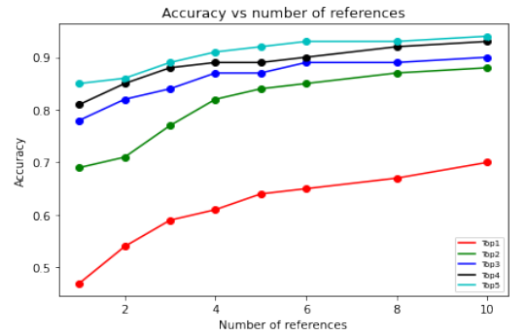

Results
Result on Subset 3 (50 classes): using VGG19 as feature extractor
Top-1 to top-5 on subset 3 Effect of number of reference
0.3.06.2021
8

Slide 9
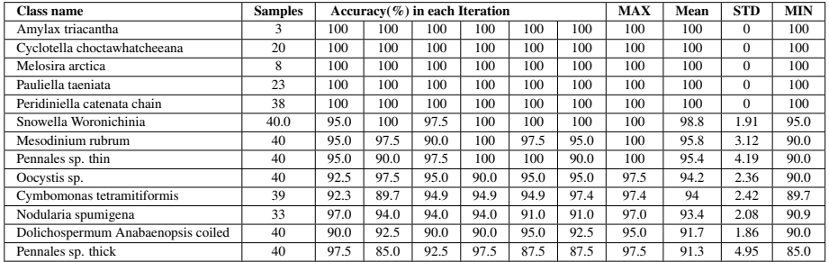
Result
Accuracy of each class is varied
Low accuracy is due to the images of that class is vary and relate to other class

Slide 10
Conclusion
The accuracy of most plankton classes is good with similarity learning even with a few example images in an unbalanced dataset without data augmentation.
The accuracy influenced by the number of reference images in the gallery set and the selection of gallery set images.
The unbalanced distribution of data does not have a notable effect on classification
However, some plankton images were not classified correctly
For the future, further investigating of architectures and similarity classifiers is needed to improve the accuracy.

Slide 11
Thank you!

